Slide 1
MEASUREMENT OF SOLAR RADIATION

Slide 2
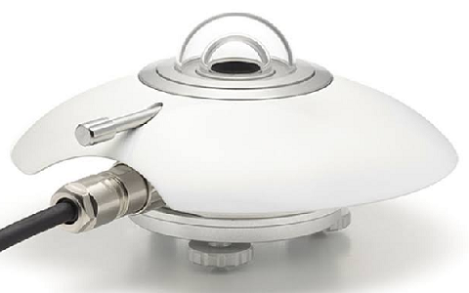
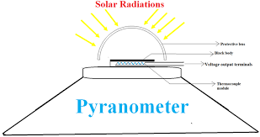

Slide 4
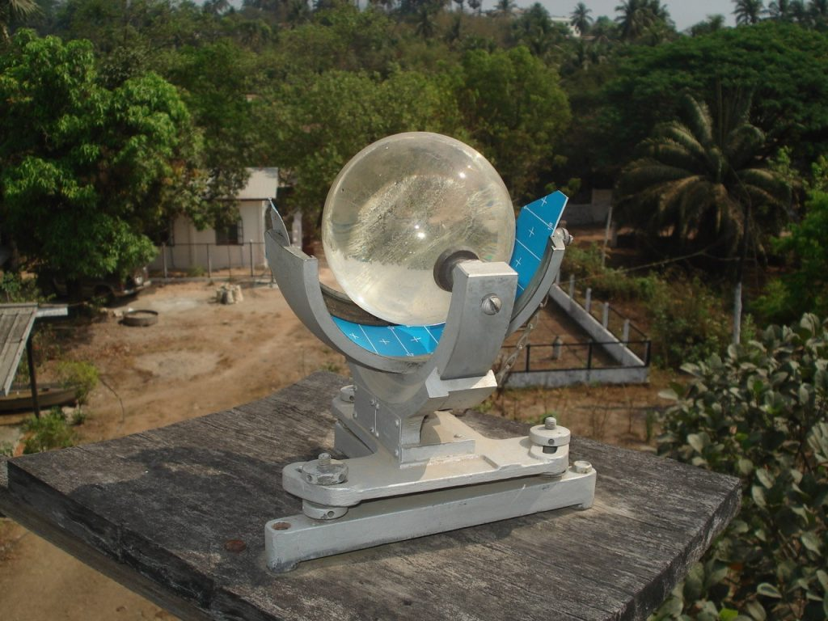
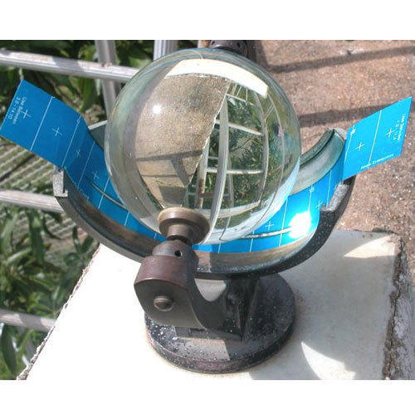

Slide 5
COLLECTION SYSTEMS

Slide 6
FLAT PLATE COLLECTORS

Slide 8
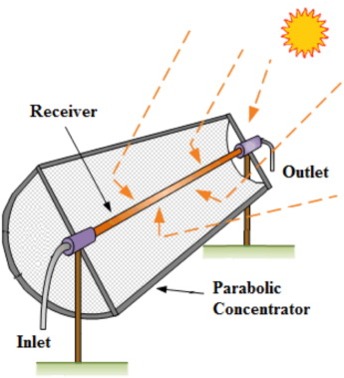
Parabolic trough collector

Slide 10
MIRROR STRIP COLLECTORS

Slide 12
FRESNEL LENS COLLECTOR

Slide 14
FLST PLATECOLLECTOR WITH ADJUSTABLE MIRRORS

Slide 16
COMPOUND PARABOLIC CONCENTRATOR

Slide 18
PARABOLIC DISH COLLECTOR

Slide 20
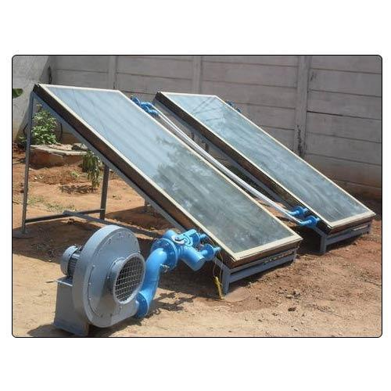
SOLAR AIR HEATER

Slide 22
SOLAR DRYERS

Slide 25
BOX TYPE SOLAR COOKING

Slide 27
DISH SOLAR COOKING

Slide 28
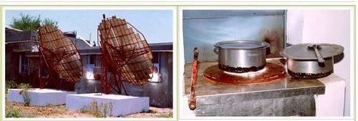
COMMUNITY SOLAR COOKING

Slide 29
SOLAR FURNACE

